Slide 1
Prediction of Protein Tertiary Structure & WSOL
Qin Wang

Slide 2
Agenda
1 Protein Tertiary Structure Prediction
2 ﻿A fully open‑source framework for deep learning protein real‑valued distances (Nature Scientific Report, Aug 31 2020)
3 ﻿Topology-Preserving Deep Image Segmentation(NIPS 2019)
4 ﻿Rethinking the Route Towards Weakly Supervised Object Localization(CVPR2020)

Slide 3
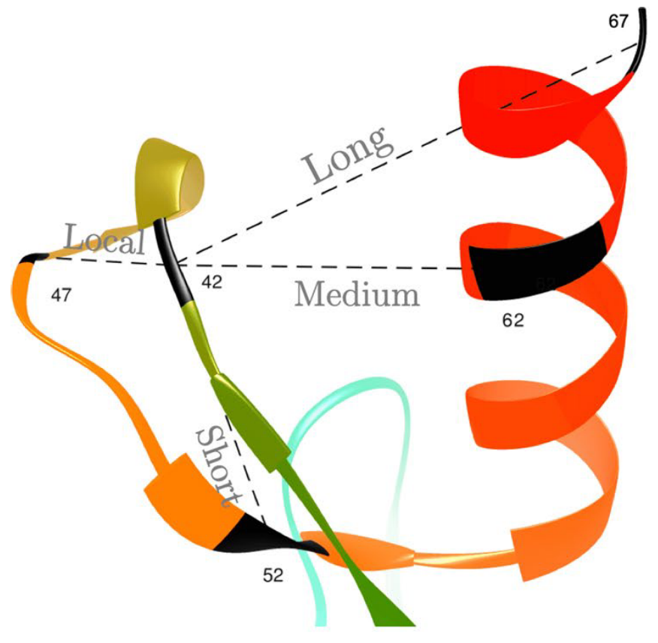
Prediction of Protein Tertiary Structure

Slide 4
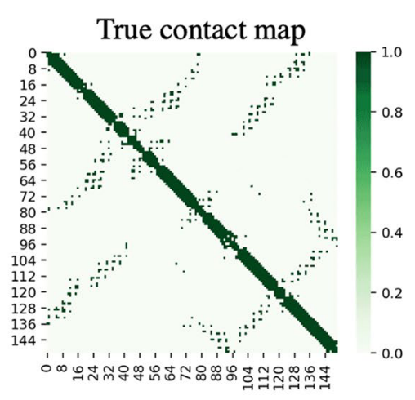
Contact Map
A protein contact map represents the distance between all possible amino acid residue pairs of a three-dimensional protein structure using a binary two-dimensional matrix. For two residues i and j, the a[i j] element of the matrix is 1 if the two residues are closer than a predetermined threshold, and 0 otherwise.

Slide 5
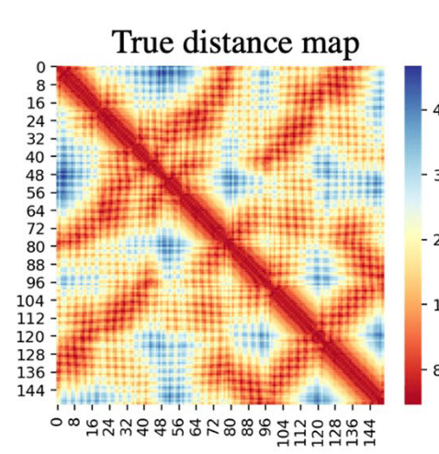
Distance Map
Distance between all possible amino acid residue pairs of a three-dimensional protein structure using a two-dimensional matrix.

Slide 6
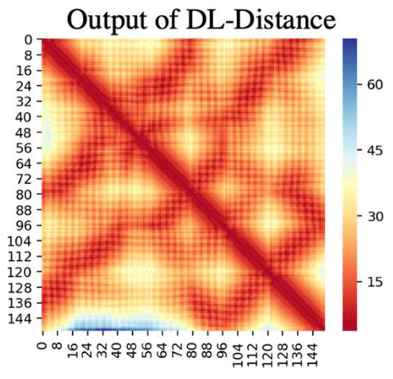
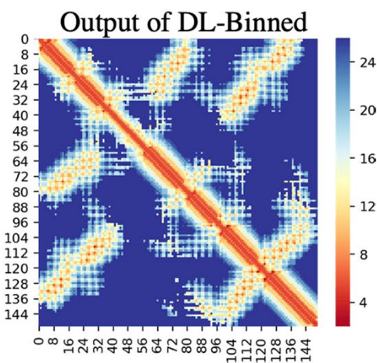
Binned Distance Map
Binned Distance between all possible amino acid residue pairs of a three-dimensional protein structure using a two-dimensional matrix.
0~100: [0, 10] [10, 20] [20, 30] …..[90, 100]

Slide 7
Protein Tertiary Structure Prediction
Predict Tertiary Structure Maps from Primary Structure of Prediction
MODEL
Features

Slide 8
﻿A fully open‑source framework for deep learning protein real‑valued distances
﻿Badri AdhikariAs

Slide 9
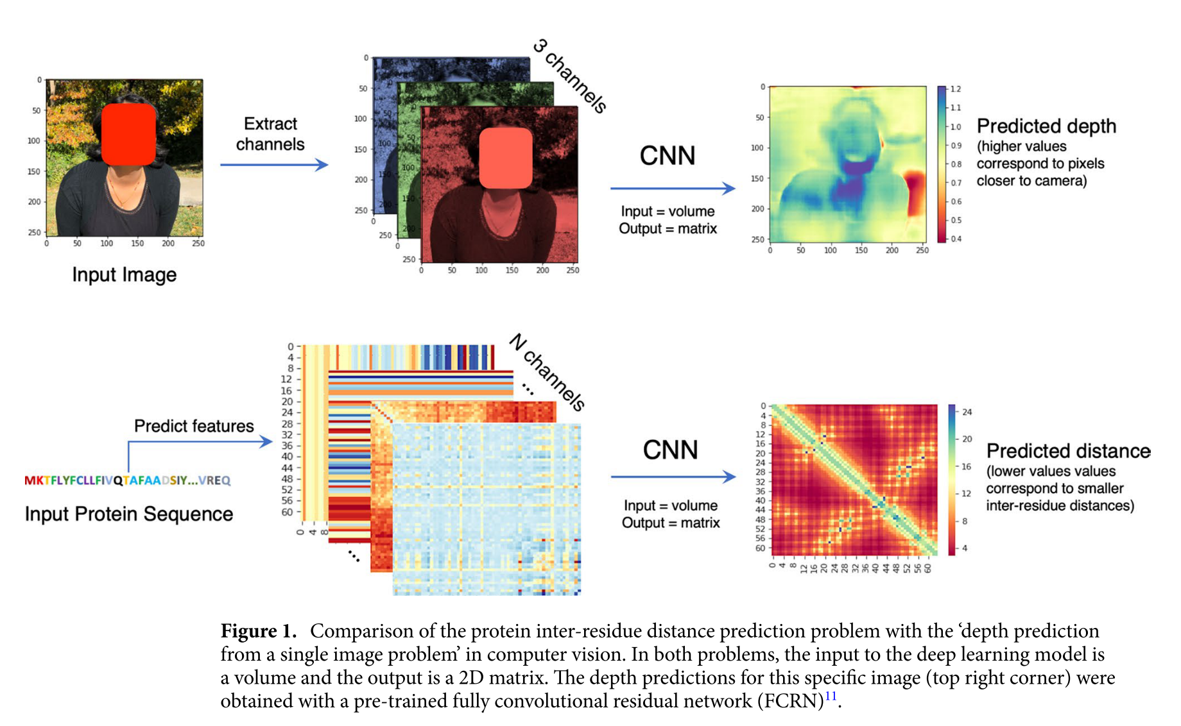
Pipeline

Slide 10
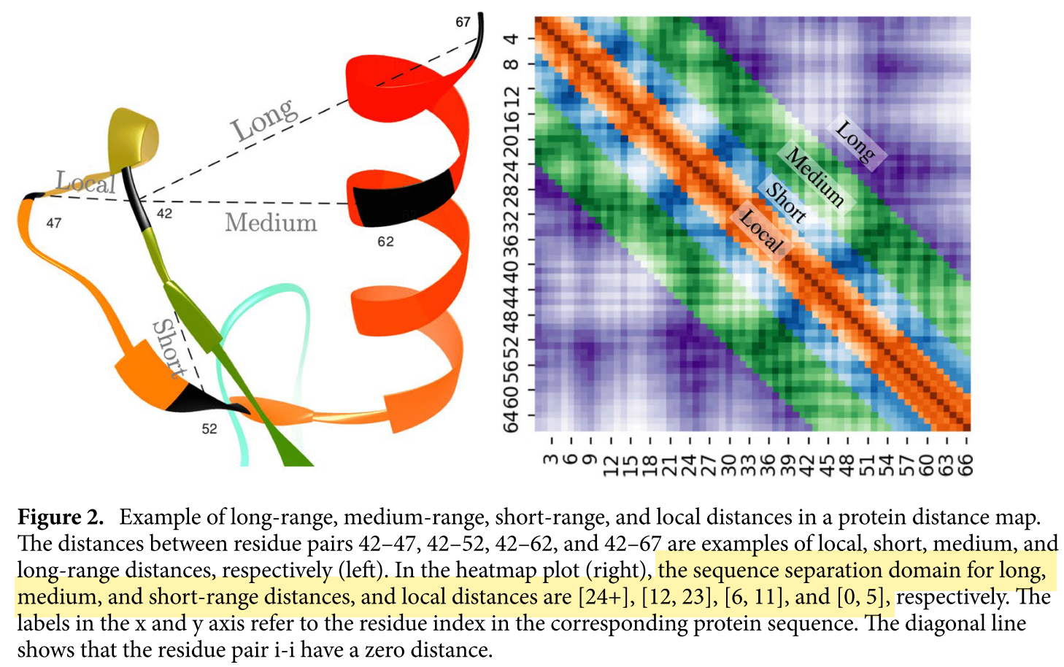
Long-range Prediction

Slide 11
Input Features
﻿(1) sequence profiles,
(2) secondary structure predictions
(3) solvent accessibil- ity predictions (with both 2 and 3 using PSIPRED22),
(4) coevolutionary signals predicted using CCMpred5,
(5) FreeContact23,
(6) contact potentials calculated from multiple sequence alignments,
(7) Shannon entropy of the alignment column.

Slide 12
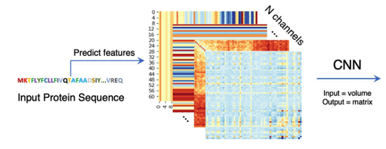
﻿Predict Contact Map
Residual Network for Classification & Binary Segmentation
﻿Using binary cross-entropy loss

Slide 13
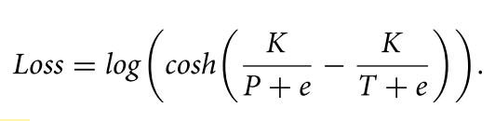
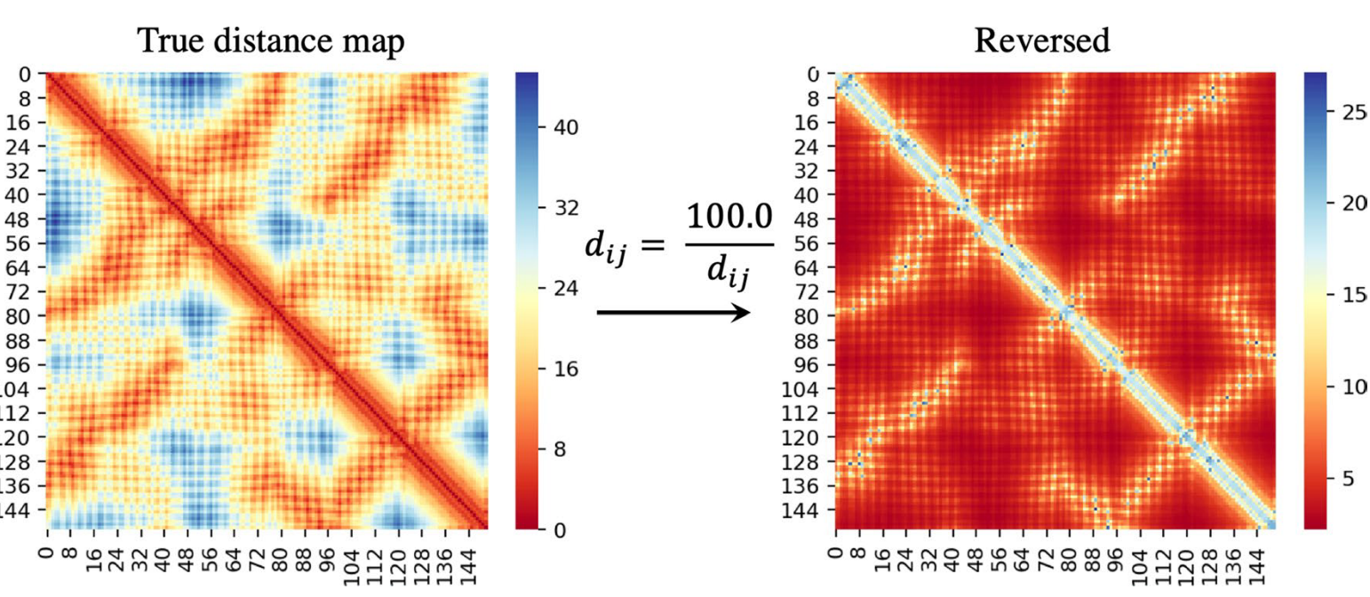
﻿Predict Distance Map
﻿This ‘reciprocal’ log cosh loss is given by
Translate the predictions into contact prediction probabilities:
Below the 8 Å threshold

Slide 14
﻿Predict Binned Distance Map
﻿Short (euclidean) distances between pairs with long-range separation (in sequence index) are more critical for structure reconstruction and other uses
﻿These thresholds for the distance bins were 4, 4.2, 4.4, ... , 8, 8.4, 9.0, 9.8, 10.8, 12, ... , 21, 23.4, 26, and 26+ Å.
Translate the predictions into contact prediction probabilities:
﻿Summed all the probabilities in the bins below the 8 Å threshold
﻿Translate the predictions into distance maps
﻿A residue pair is the range [6.5, 7], then the predicted distance becomes 6.75 Å.
﻿Standard categorical cross-entropy loss

Slide 15
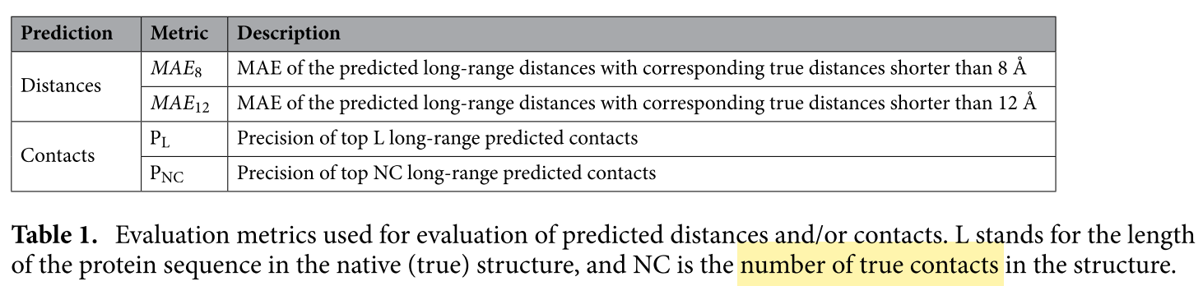
Metric

Slide 16
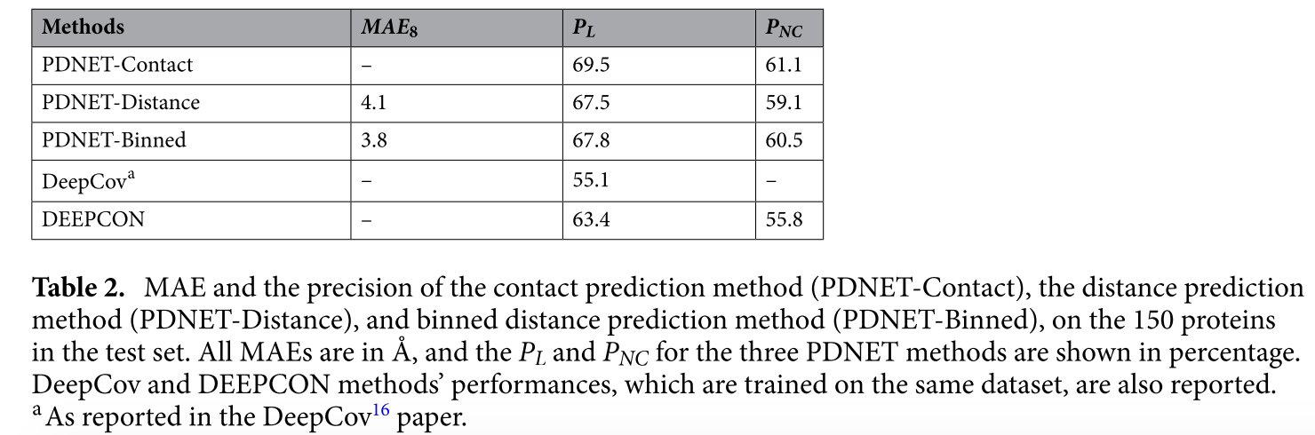
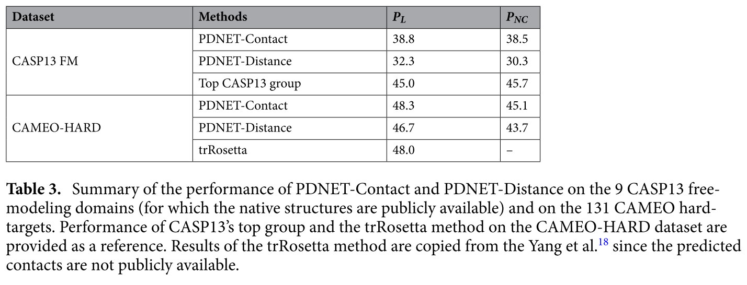
Result

Slide 17
﻿Topology-Preserving Deep Image Segmentation
﻿∗Xiaoling Hu1, Li Fuxin2, Dimitris Samaras1 and Chao Chen1 1Stony Brook University 2 Oregon State University

Slide 18
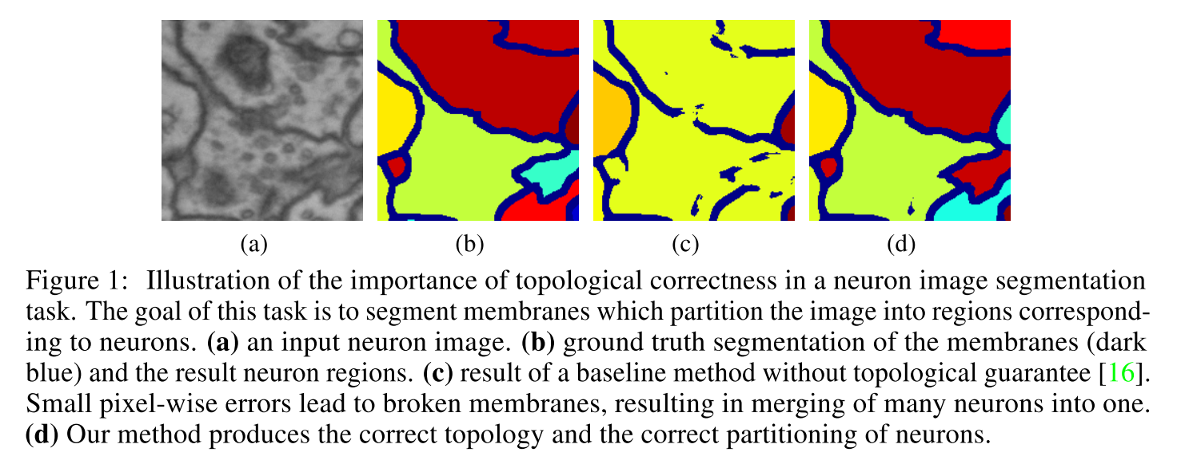
Task
2D image ﻿Biomedical Segmentation

Slide 19
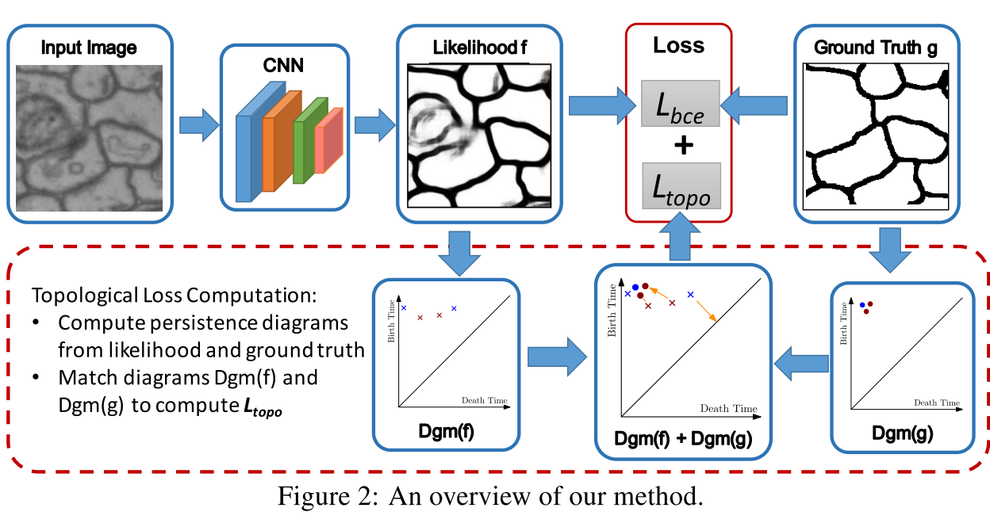
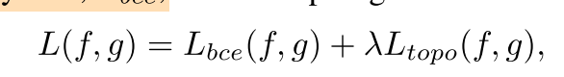
Method
﻿TopoNet is the first end-to-end deep segmentation network with guaranteed topological correctness

Slide 20
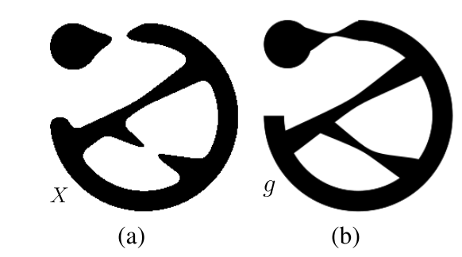
﻿Betti number
﻿Number of connected components and handles

Slide 21
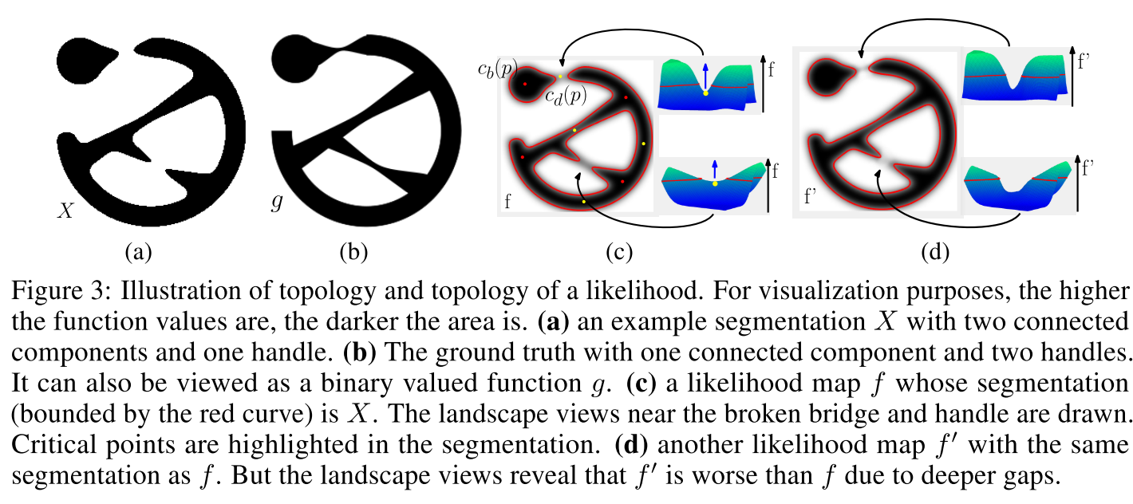
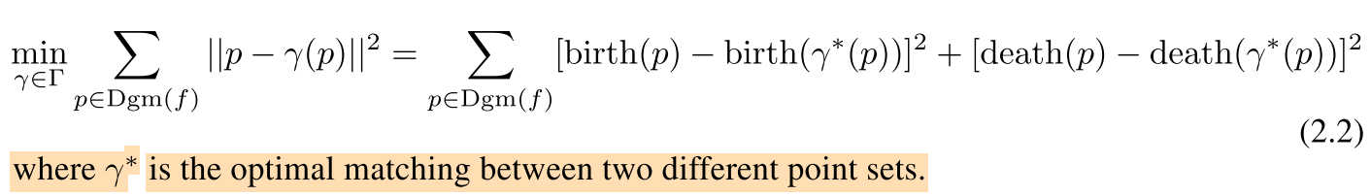
Differentiable Betti number
Death and Birth Points

Slide 22
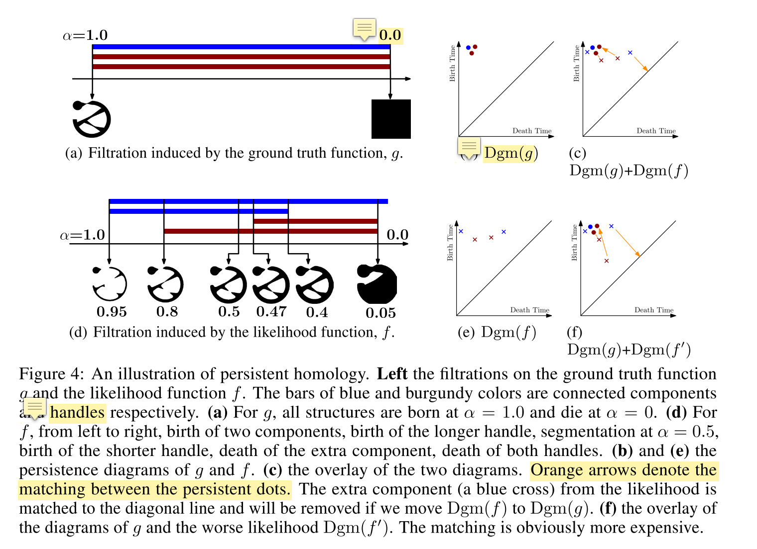
Method

Slide 23
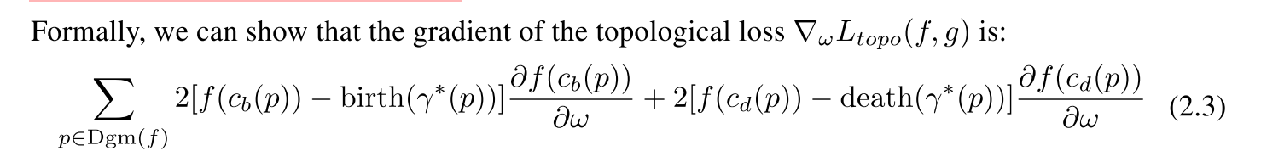
Topology Loss

Slide 24
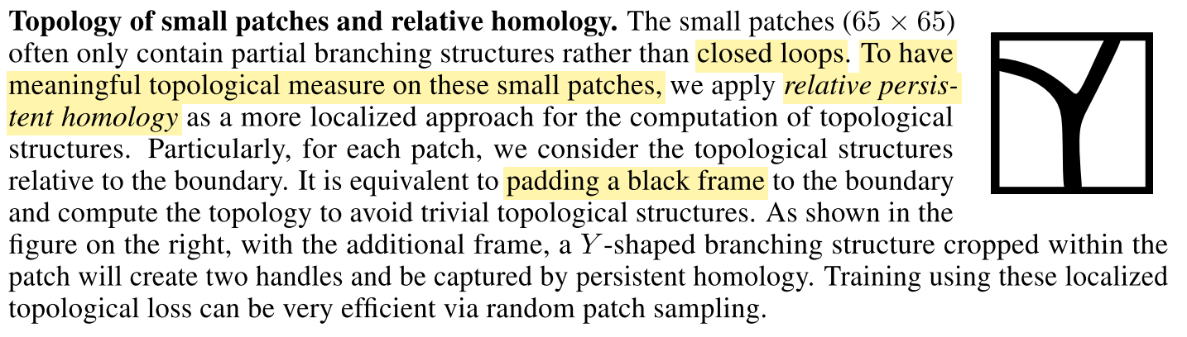
Experiment

Slide 25
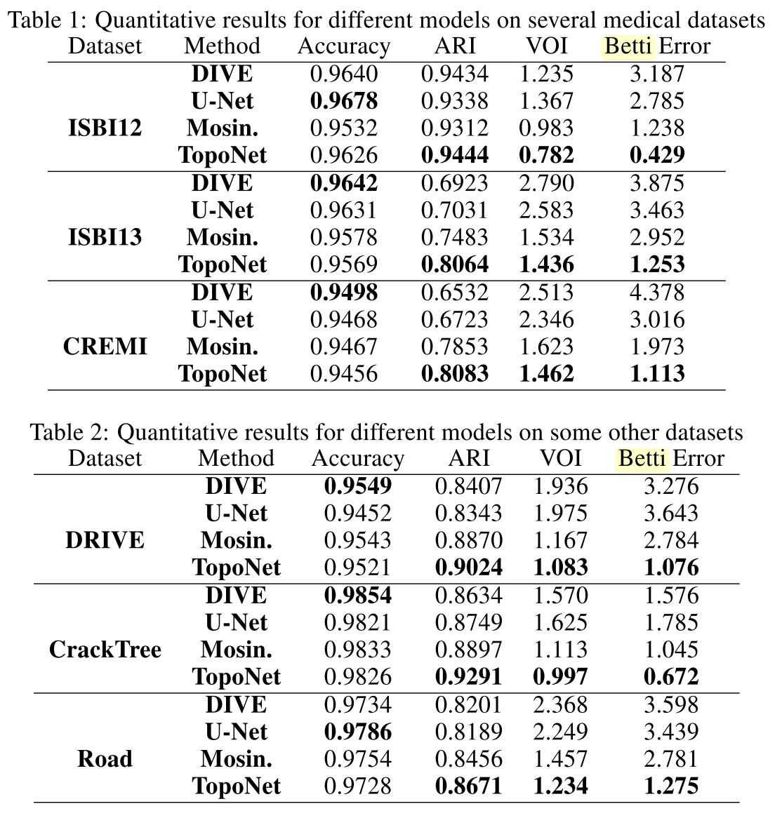
Experiment

Slide 26
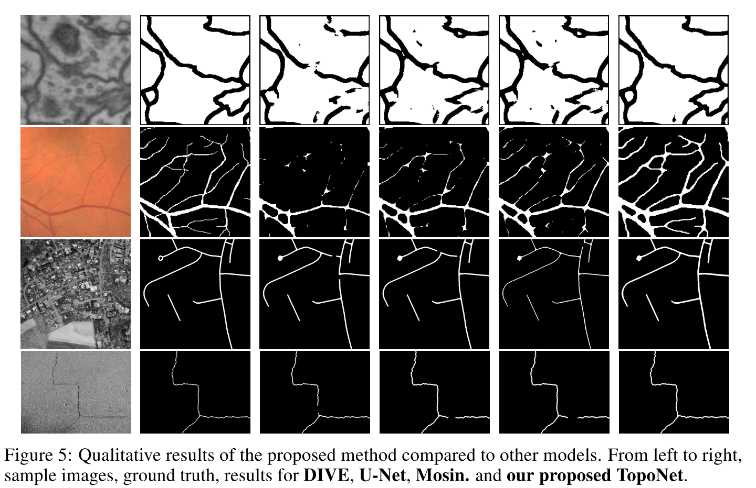
Experiment

Slide 27
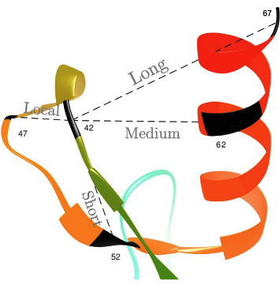
Discuss: Homology of Protein Tertiary Prediction?

Slide 28
﻿Rethinking the Route Towards Weakly Supervised Object Localization
﻿Chen-Lin Zhang Yun-Hao Cao Jianxin Wu∗ National Key Laboratory for Novel Software Technology Nanjing University, Nanjing, China

Slide 29
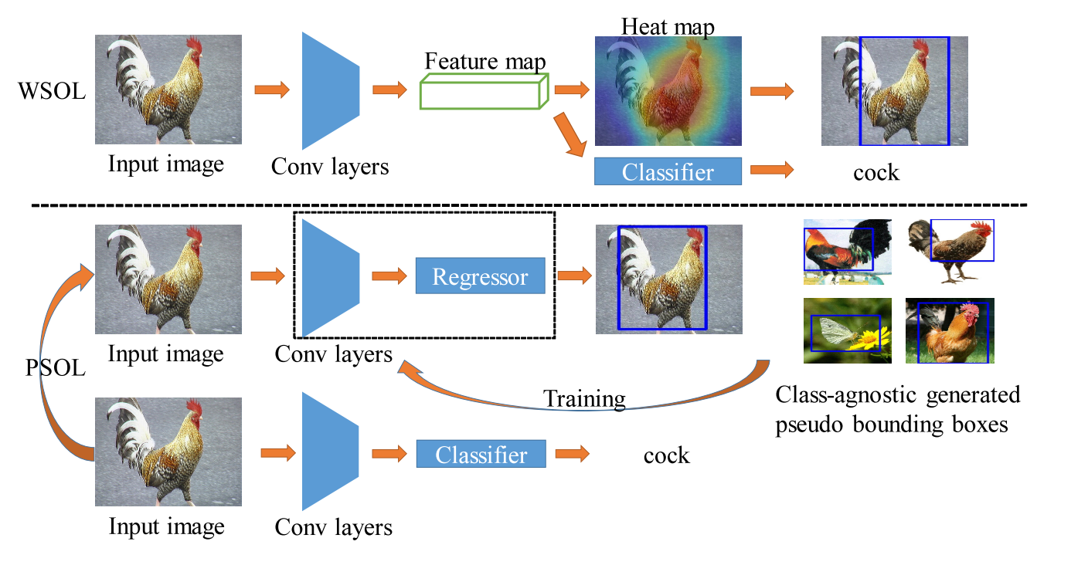
Method

Slide 30
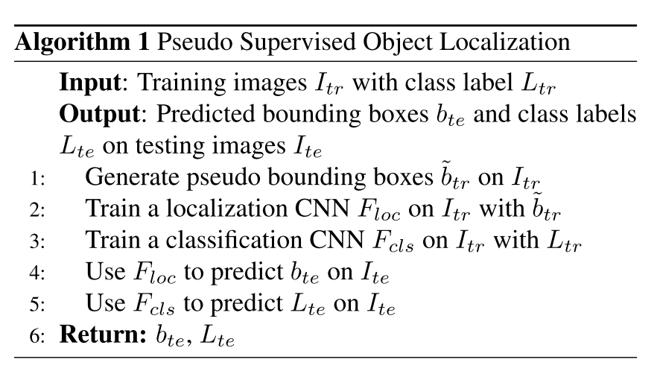
Method

Slide 31
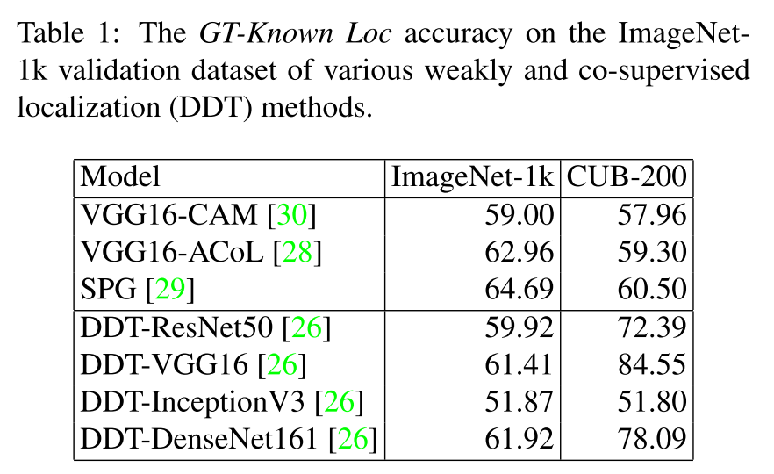
Result

Slide 32
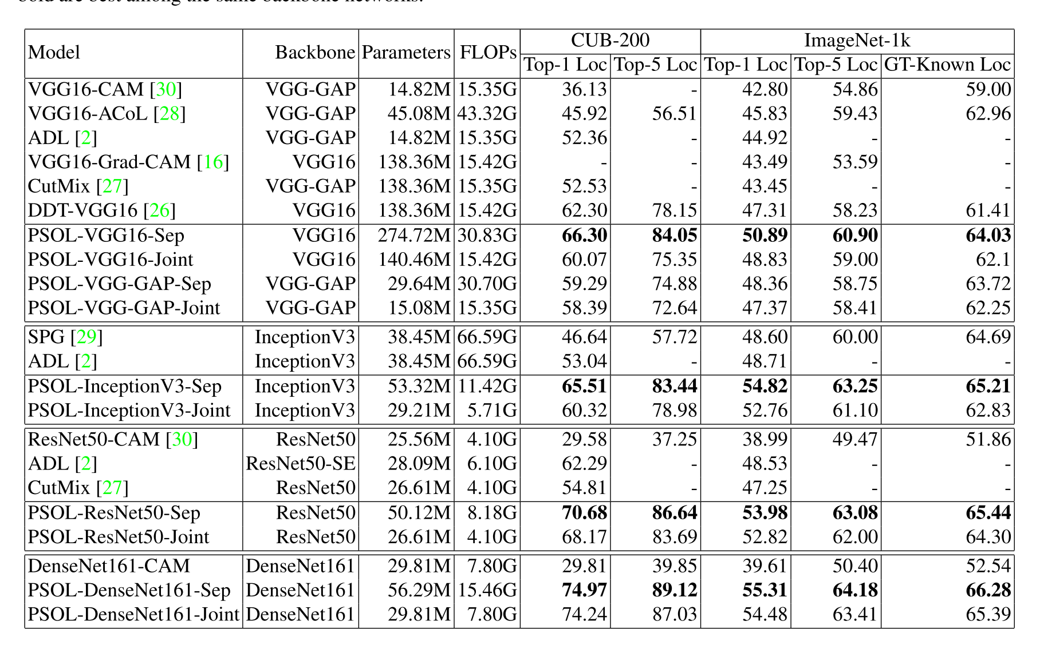
Thanks

Slide 33
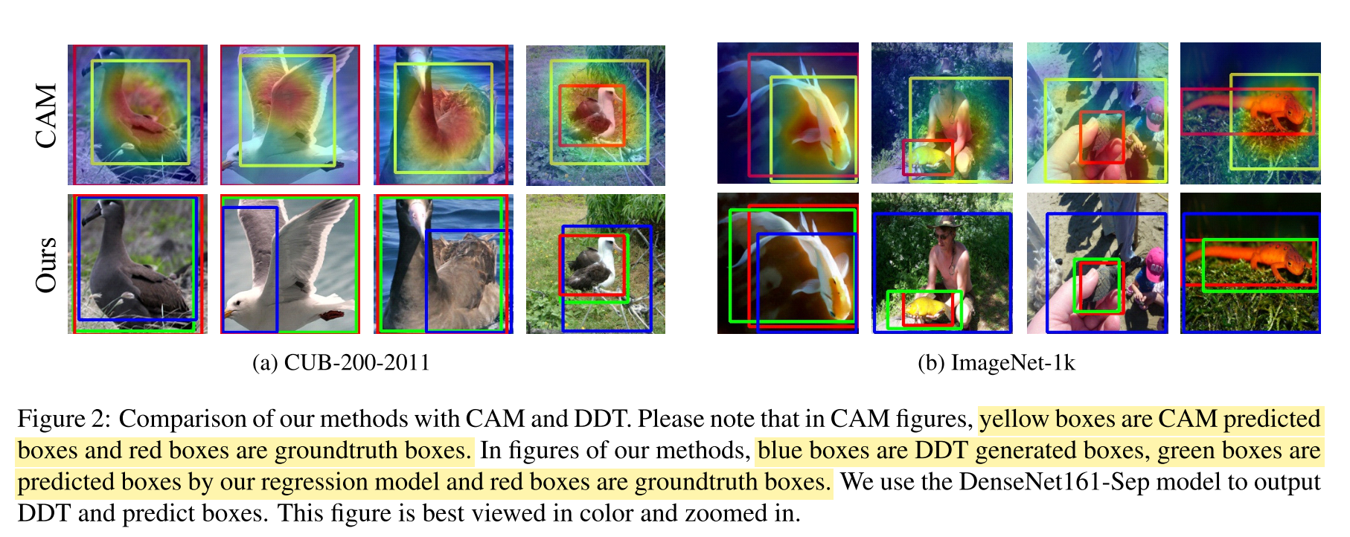

Slide 34
Thanks

